Slide 1
Deploying a cloud-based
Red Team attack infrastructure
- It’s not all about the ‘breaking in’! ☺ -
Leo McCavana, RGU, 11th March 2020

Slide 2

> whois Leo (@jckhmr_t)
Red Team Operator for Fortune 500 company
Been in Information Security for 15+ years
Tech writing > Security Architecture > Pen Testing > Red Teaming
Previous life: bad programmer (web, ‘new media’)
Interested in: automation, breaking stuff
Occasional t-shirt winner
Long distance cyclist (not very fast)

Slide 3

On the agenda
What?
It’s not all about the attacking*
Red Team attack infrastructure - challenges
Using automation to build an attack infrastructure
Automation infrastructure attacks
* with written permission!
Notes:
Why haven’t we automated you yet? Mistaken believe that all aspects of appsec pen testing could always be automated

Slide 4

What?
So many names …
Pen testing/Penetration testing
Ethical hacking
Red Teaming
Offensive Security
Notes:
Why haven’t we automated you yet? Mistaken believe that all aspects of appsec pen testing could always be automated

Slide 5

It’s not all about the attacking …
Myth: we just ‘break’ things
If performing an operation on cloud environments, it makes sense to work from a cloud environment too.
Those ‘attack’ cloud environments have to be built too! ☺
Speed/agility/scalability of working with/from the cloud
Notes:
Why haven’t we automated you yet? Mistaken believe that all aspects of appsec pen testing could always be automated

Slide 6
It’s not all about the attacking …
Myth: we just ‘break’ things
Goal = make organizations more secure, so:
perform threat emulation activities as to how actual production systems can be attacked.
Testing and helping improve defensive capabilities.
Often requires creating a ‘copy’ of the target infrastructure (or a part of it).
Notes:
Why haven’t we automated you yet? Mistaken believe that all aspects of appsec pen testing could always be automated

Slide 7
It’s not all about the attacking …
Myth: we just ‘break’ things
Rarely a case of ‘point, click’ and ‘I’m in’.
Unique environments require unique solutions to attack them.
Social engineering is becoming more necessary.
Notes:
Why haven’t we automated you yet? Mistaken believe that all aspects of appsec pen testing could always be automated

Slide 8
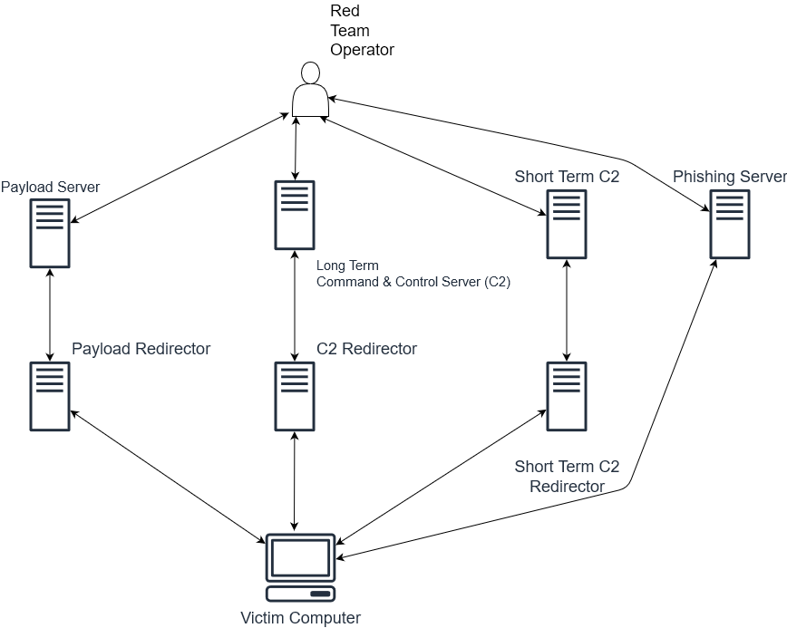
Red Team attack infrastructure – some challenges
Simplified attack infrastructure
Notes:
Why haven’t we automated you yet? Mistaken believe that all aspects of appsec pen testing could always be automated

Slide 9

Red Team attack infrastructure – some challenges
How long to do ALL of this, just for ONE element (phishing) of an attack infrastructure?
Create ‘Machine’ in control panel
Updates
DNS Records
SSL certificates
Install attack components
Configure attack components
Testing (again)

Slide 10
Red Team attack infrastructure – some challenges
Human ‘problems’ to address
Scalability
Speed
Consistency
Repeating ourselves/re-inventing the wheel
Notes:
Why haven’t we automated you yet? Mistaken believe that all aspects of appsec pen testing could always be automated

Slide 11
Red Team attack infrastructure – some challenges
More ‘sysadmin’ time bites into
a time limited attack operation …
Notes:
Why haven’t we automated you yet? Mistaken believe that all aspects of appsec pen testing could always be automated

Slide 12
Red Team attack infrastructure – some challenges
We need a different approach!
Notes:
Why haven’t we automated you yet? Mistaken believe that all aspects of appsec pen testing could always be automated

Slide 13
Introducing ‘Infrastructure as Code’
What?
Quite literally, being able to define infrastructure as lines of code
Emphasis is on a ‘desired end state’ and not ‘how’
Notes:
Why haven’t we automated you yet? Mistaken believe that all aspects of appsec pen testing could always be automated

Slide 14
Introducing ‘Infrastructure as Code’
What?
Scalability, speed and consistency improved
Other benefits: standardization and automation increases reliability (less testing) and is a lot more modular (plug and play components)
Notes:
Why haven’t we automated you yet? Mistaken believe that all aspects of appsec pen testing could always be automated

Slide 15
Introducing ‘Infrastructure as Code’
What?
Two important pieces of the solution:
Orchestration
Configuration management
Notes:
Why haven’t we automated you yet? Mistaken believe that all aspects of appsec pen testing could always be automated

Slide 16

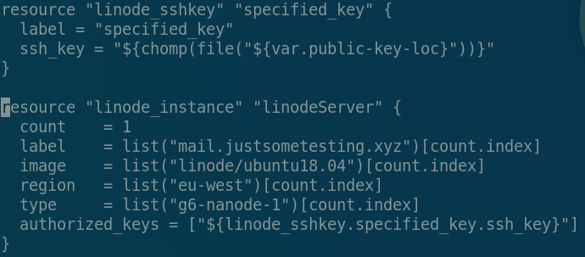
Using Automation to Build an Attack Infrastructure
Orchestration: Introducing Terraform
Used to build the basic infrastructure
Simple human readable syntax to define requirements
Works with lots of different cloud providers
Cross platform
Notes:
Why haven’t we automated you yet? Mistaken believe that all aspects of appsec pen testing could always be automated

Slide 17
Using Automation to Build an Attack Infrastructure
Orchestration: from code to new server(s)
3 commands:
terraform init (sets up the provisioning environment)
terraform plan (a pre-flight check for syntax etc)
terraform apply (communicates with the cloud provider API to build the server)
… and you are ready to login to the box via ssh!
Note: Terraform will also need your cloud provider API keys/tokens specified in a support file.
Notes:
Why haven’t we automated you yet? Mistaken believe that all aspects of appsec pen testing could always be automated

Slide 18

Using Automation to Build an Attack Infrastructure
Ansible
Configuring what you built with Terraform and turning it into something ‘useful’
Phishing server
Command and Control (C2) Server
Payload servers
Redirectors etc, etc

Slide 19
Using Automation to Build an Attack Infrastructure
Ansible: Reasons to like it
Agentless
Uses SSH (.nix/Mac) and WinRM (M$ Windoze)
Integration
Although independent, it works well with Terraform and other tools like Vagrant
Easy to follow syntax
YAML
Procedural. You tell it what you want and it does it for you

Slide 20
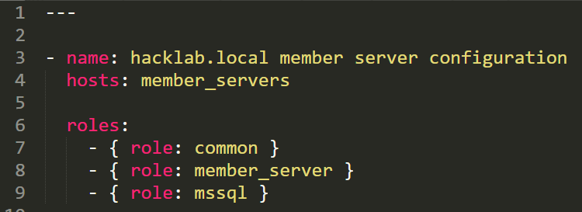
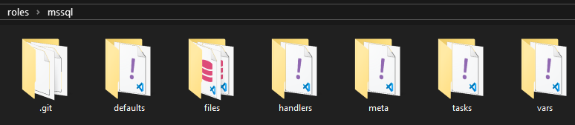
Using Automation to Build an Attack Infrastructure
Ansible Building Blocks: Roles
A collection of tasks that have a common purpose – for example, the list of commands that are needed to configure a server as a domain controller or an attack infrastructure

Slide 21
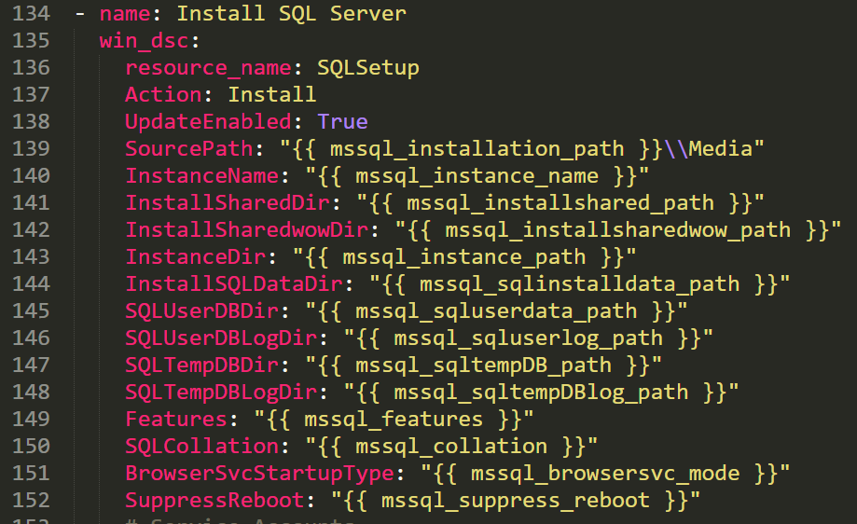
Using Automation to Build an Attack Infrastructure
Ansible Building Blocks: Tasks
All of the small individual steps that make up a role.
For example, installing some software pre-reqs, joining a computer to a domain, transferring files etc.

Slide 22
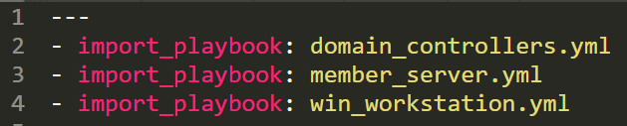
Using Automation to Build an Attack Infrastructure
Ansible Building Blocks
Playbooks
A playbook in sport maps all the key moves to win the game (ideally)
Think of them as the link between a list of servers and the roles that get implemented.
We could have a playbook to stand up a complete system of servers and workstations – each containing a list of roles.

Slide 23
Using Automation to Build an Attack Infrastructure
Putting it all together
You can now build an attack infrastructure in about 20 minutes.
Consistent. Repeatable. Reliable. Reusable. Extendable
Create, configure, manage and then tear down (complete lifecycle management)

Slide 24
Cloud Infrastructure Attacks
Attacking and weaponization

Slide 25
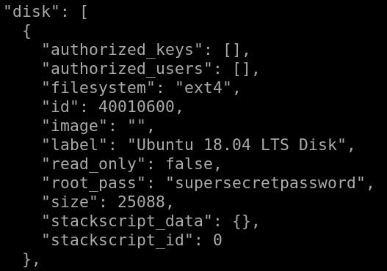
Cloud Infrastructure Attacks
Scenario: An attacker gains a foothold on a
Terraform ‘Build Machine’
terraform.tfstate and terraform.tfstate.backup files are used to manage ‘session state’. Essentially a bundle of settings for a built environment
Can you see what has gone wrong?
Root creds! Lateral movement ….

Slide 26
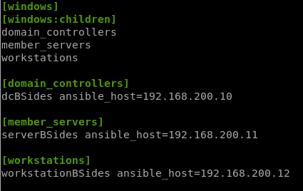
Cloud Infrastructure Attacks
Scenario: An attacker gains a foothold on an Ansible Controller
By design, an Ansible Controller has root access to an inventory of servers/workstations.

Slide 27

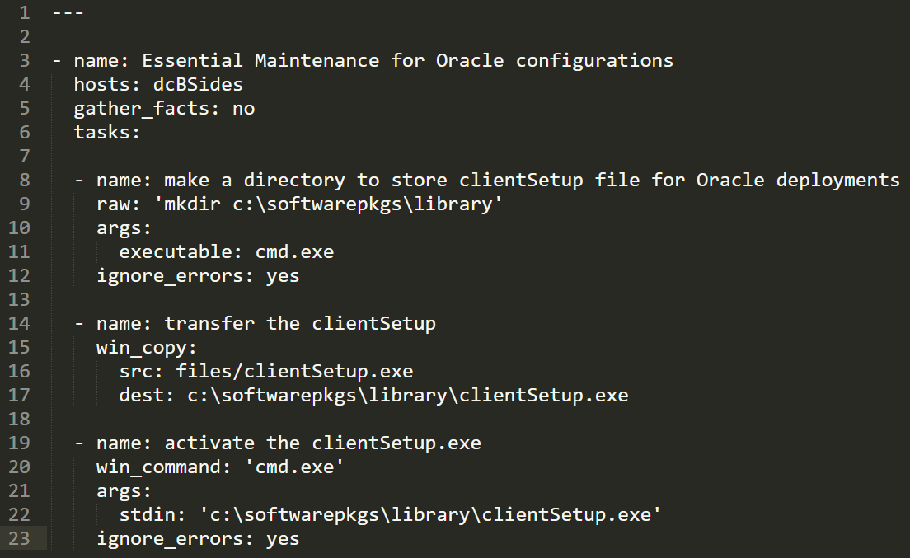
Weaponizing Ansible: Does this look normal?
Notes:
Make it look ‘normal’ … Talk about the use of the win_copy feature instead of other mechs such as certutil

Slide 28
Weaponizing Ansible
Of course it does, but
it’s anything BUT normal …

Slide 29
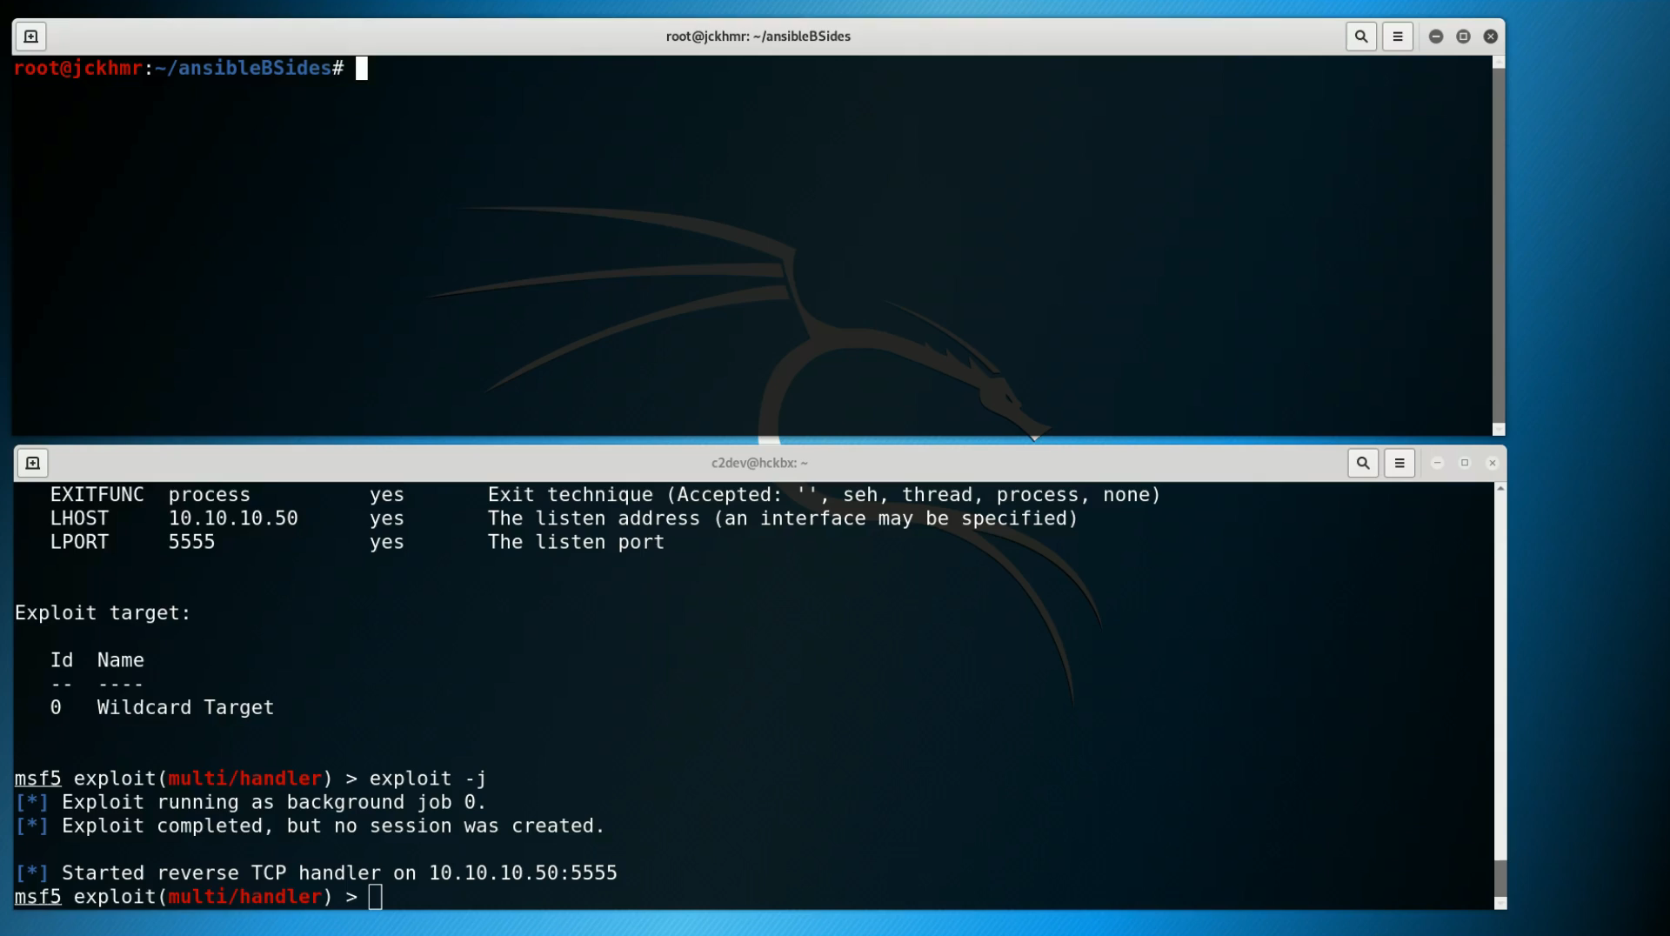

Slide 30
Fixing the problems
Ansible and Terraform by
themselves are not ‘vulnerable’

Slide 31
Fixing the problems
Ansible and Terraform by
themselves are not ‘vulnerable’
The same old rules of system hardening, patch management, authentication, authorization and
Accountability still stand.
Get the basics right …

Slide 32
There’s just one more thing …
I like Ansible and Terraform … but they
require my stretched team to
learn yet more tools and ‘scripting’.

Slide 33
There’s just one more thing …
Introducing ‘redEngine’ …
asks what type of components you want for an attack infrastructure.
Generates and customizes the Terraform & Ansible code
Creates the raw servers and configures everything for you.
Generates and deploys SSL certificates
Complete setup of phishing server (complete with DKIM, SPF and DMARC)
Multiple other roles: multiple C2 systems, redirectors, payload etc
Notifications to Slack
Can be utilized by non Terraform/Ansible specialists
Automating the automation! (yes, it’s a ‘thing’)
Status: Internal Beta
Another demo? Why not!

Slide 34
Thank you.
Questions?
jckhmr.net @jckhmr_t
github.com/jckhmr
jckhmr@posteo.net

